Slide 2
Project Details
Project title: Data security and privacy for an end to end message communication.
MEMBER’S NAME | ROLL NUMBER | SAP ID | BRANCH
Anushka Bhardwaj | R114218004 | 500068040 | CSE ECRA
Rima Giri | R114218016 | 500069082 | CSE ECRA
Vaishnavie | R133218029 | 500069265 | CSE BFSI
Under the guidance of
Dr. Amitava Choudhury
Assistant Professor, Department of Informatics,
School of Computer Science,
UNIVERSITY OF PETROLEUM & ENERGY STUDIES

Slide 3
Contents
Abstract
Problem Statement
Objective
Methodology
Pseudo code
Project Schedule
Outcome
References

Slide 4
Abstract
Aims at taking a step into the field of data security by creating a machine that is capable of data encryption.
The plain text is converted into the coded message or ciphertext after encryption for transmission.
At the receiver’s end, this coded message is converted back to the original message, that the sender sent.

Slide 5
Introduction
Cryptography is essentially important because it allows you to securely protect data that you don’t want anyone else to have access to. It is used to protect corporate secrets, secure classified information, and to protect personal information to guard against things like identity theft. [1]
Cryptography is the study and practice of a set of techniques used to protect the integrity of networks, programs, and data from attack, damage, or unauthorized access.
The main goal of cryptography is to make communication secure.

Slide 6
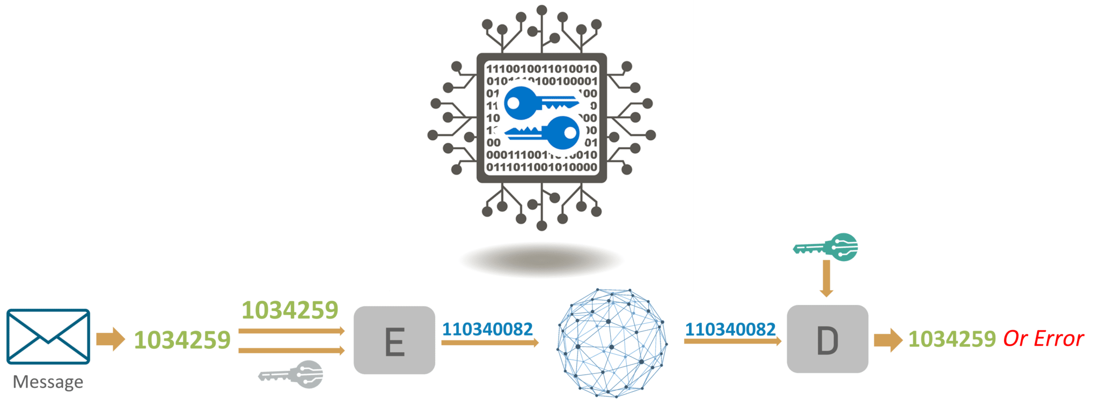
How Cryptography works
Figure 1: Cryptography [1]

Slide 7
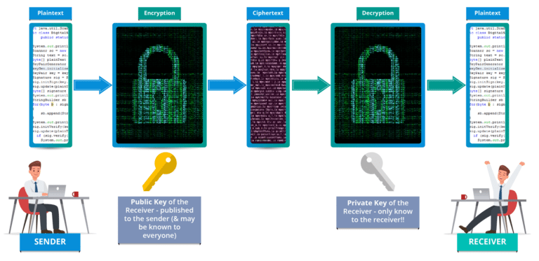
Asymmetric key cryptography
Asymmetric key cryptography, also known as Public-key cryptography is any cryptographic system that
uses a pair of keys which is a public that may be emanated widely and private keys which may be known
only to the owner.
Figure 2: Asymmetric key cryptography [1]

Slide 8
Problem Statement
There are many challenges faced by people while communicating
between two devices. There is a chance to steal and manipulate
data, so we need data security and privacy for an end to end
message communication.

Slide 9
Objectives
Data integrity: The receiver of a message should be able to check whether the message was modiﬁed during transmission, either accidentally or deliberately. No one should be able to substitute a false message for the original message, or for parts of it.
Authentication: The receiver of a message should be able to verify its origin.
Non-repudiation: The sender should not be able to later deny that she sent a message.

Slide 10
Literature Review
In recent years network security has become an important issue. Encryption has come up as a solution, and plays an important role in the information security system.
Data Encryption Standard(DES) [2] algorithm purpose is to provide a standard method for protecting sensitive commercial and unclassified data. In this same key used for encryption and decryption process.
Advanced Encryption Standard (AES) [2] algorithm not only for security but also for great speed. Both hardware and software implementation are faster still. New encryption standard recommended by NIST to replace DES. Encrypts data blocks of 128 bits in 10, 12 and 14 rounds depending on key size.

Slide 11
Data Encryption Standard (DES) [2]
It can encrypt 64 bits of plain text using 56 bit of key length.
Before initial permutation, the plaintext is divided into 2 halves, that is, 32 bit of left plain text and 32 bit of right plain text.
After final permutation, these two halves are rejoined and we get the ciphertext of 64 bit block as an output.

Slide 12
Advanced Encryption Standard (AES) [2]
It can encrypt 128 bit of plaintext and key length can be of 128 bits, which includes 10 rounds of operation.
In AES, we have different key lengths, that is, 192 bit key which includes 12 round operation and for 256 bit key, it includes 14 round operation.
It is known for higher security and great speed.

Slide 13
Methodology: RSA Algorithm
This involves a public key and a private key. The public key can be known to everyone- it is used to encrypt messages. Messages encrypted using the public key can only be decrypted with the private key. [3]
It is an asymmetric cryptographic algorithm.
The keys for the RSA algorithm are generated in the following way:

Slide 14
RSA Algorithm workflow
Select two prime numbers, p and q.
Calculate n, where n is used for modulus of private and public key, and is calculated by: n = p * q
Calculate totient and e (encryption key) using gcd(e,phi(n)) = 1
Calculate d (decryption key) using the formula:
(d * e) mod phi(n) = 1
These calculations are used for encryption (e, n) and for decryption (d, n).

Slide 15
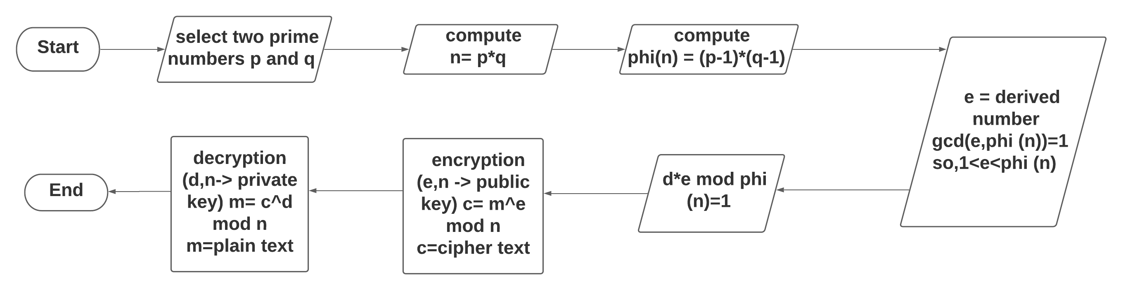
RSA Algorithm Flowchart…
Figure 3: Flowchart of RSA algorithm

Slide 16
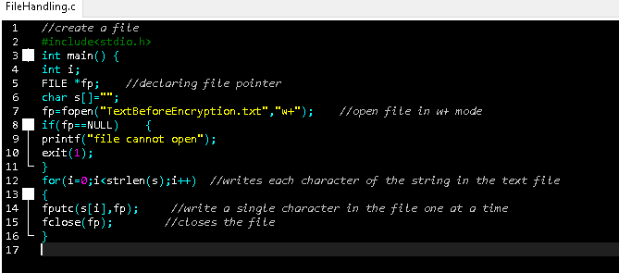
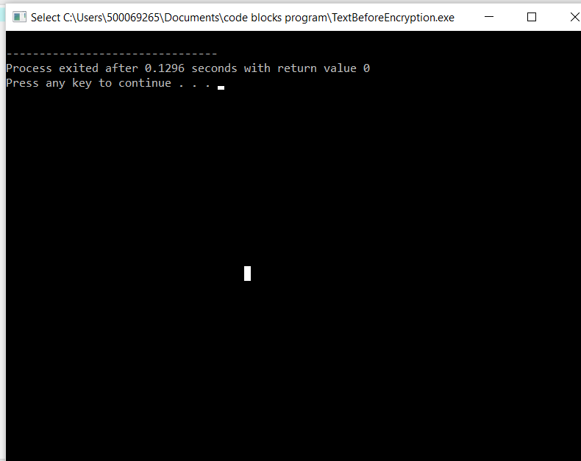
Pseudo code
STEP 1: Create a file using File handling.
fp=fopen("TextBeforeEncryption.txt","w+");
Here, w+ used to create a text file for update, discard previous contents if any.
Figure 4: creating a file
Figure 5: output of
the file created

Slide 17
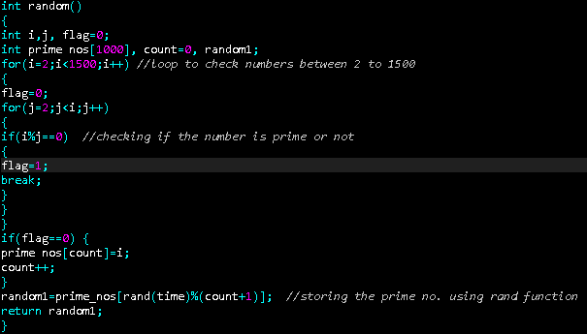
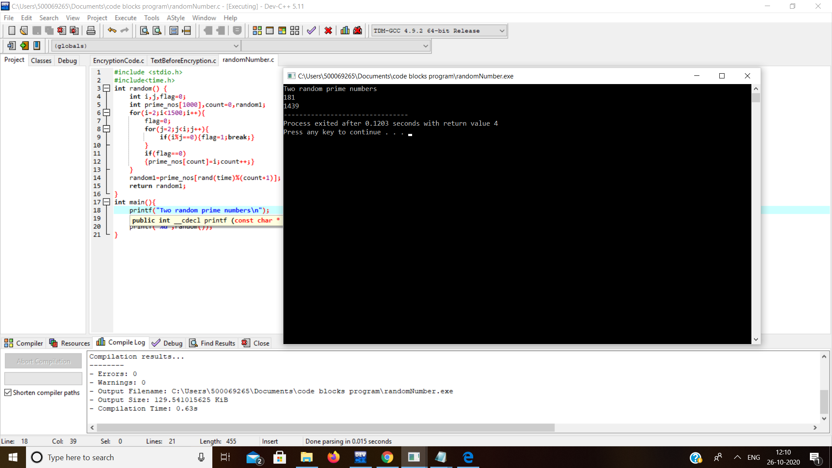
Pseudo code
STEP 2: Generate two prime numbers using random function. [4]
int random() // random function
{
int i,j,flag=0;
int prime_nos[1000], count=0, random1; //prime number till 1000
random1=prime_nos[rand(time)%(count+1)]; }
/*In order to produce random integer numbers within a specified range, you need to manipulate the rand( ) function. */
Figure 6: declaring random function
Figure 7: Prime numbers are generated using random function

Slide 18
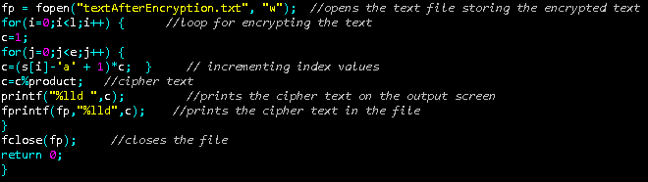
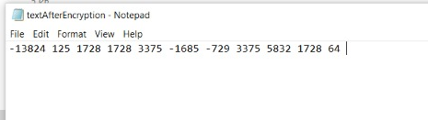
Pseudo code
STEP 3: Now the Text file which is created
in step 1 is used to store the
message which we have to encrypt.
fp=fopen("TextAfterEncryption.txt","w");
Here, w is used to write and create a file.
Figure 8: Text after encryption
Figure 9: Encrypted text

Slide 19
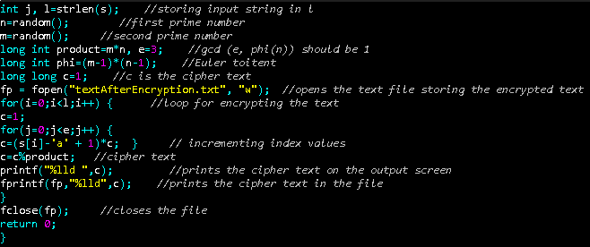
Pseudo code
Step 4: Calculate n, e, phi(n)
long int product=m*n, e=3; [4]
/*calculate n, e is less than phi(n)
and gcd(e, phi(n)=1), e=3 satisfies
current value.*/
long int phi=(m-1)*(n-1); /*phi(n) Euler totient*/
c=(s[i]-'a' + 1)*c;
/*Difference from a to s[i] power c*/
c=c%product; // cipher text
Figure 10: Code for encryption

Slide 20
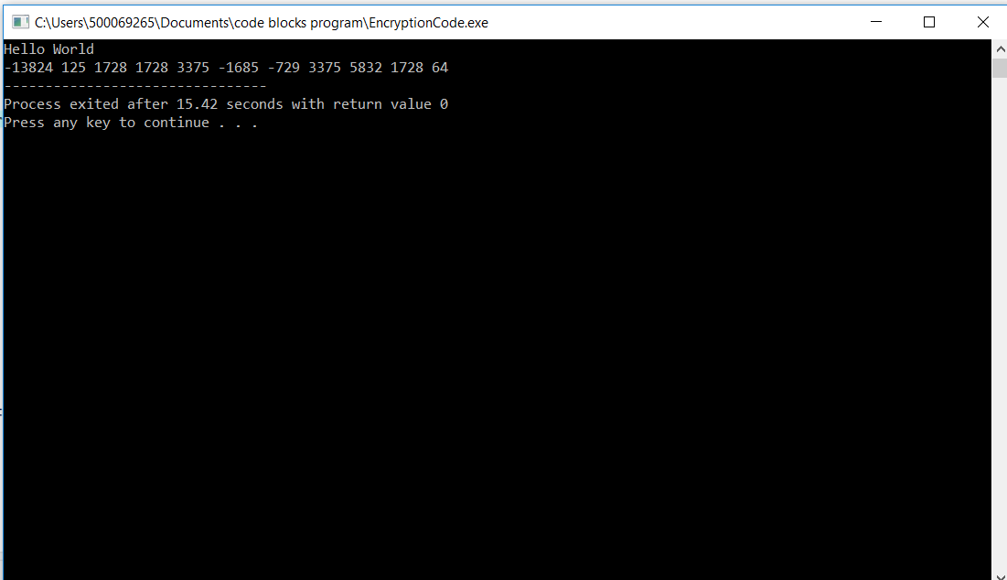
Pseudo code
Figure 11: Final output of the encrypted text

Slide 21
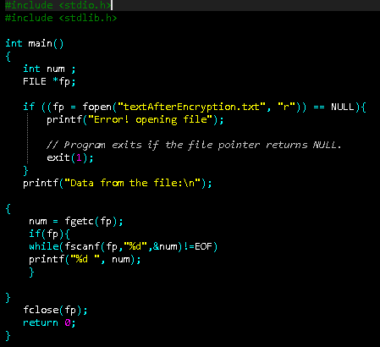
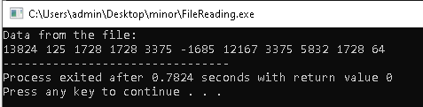
Pseudo code
STEP 5: Creating a function to read the files
if ((fp = fopen("textAfterEncryption.txt", "r")) == NULL){
printf("Error! opening file");
// Program exits if the file pointer returns NULL.
exit(1);
}
printf("Data from the file:\n");
Figure 12: Function for reading a file
Figure 13: output of the file reading function

Slide 22
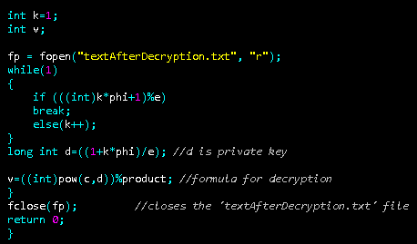
Pseudo code
Step 6: Decrypting the cipher text back to the plain text [6]
long int d=((1+k*phi)/e);
//d is private key
v=((int)pow(c,d))%product;
//formula for decryption
Figure 14: Code for decryption

Slide 23
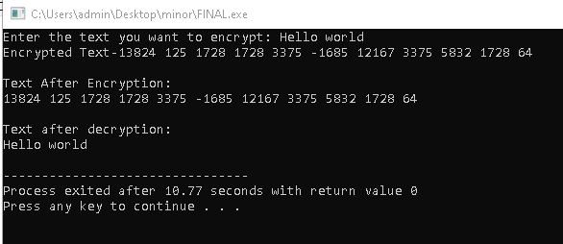
Pseudo code
Figure 15: Final output

Slide 24
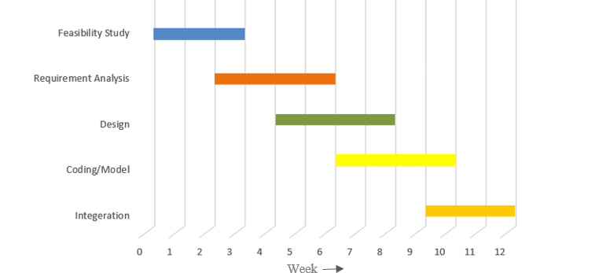
Schedule
Figure 16: Schedule

Slide 25
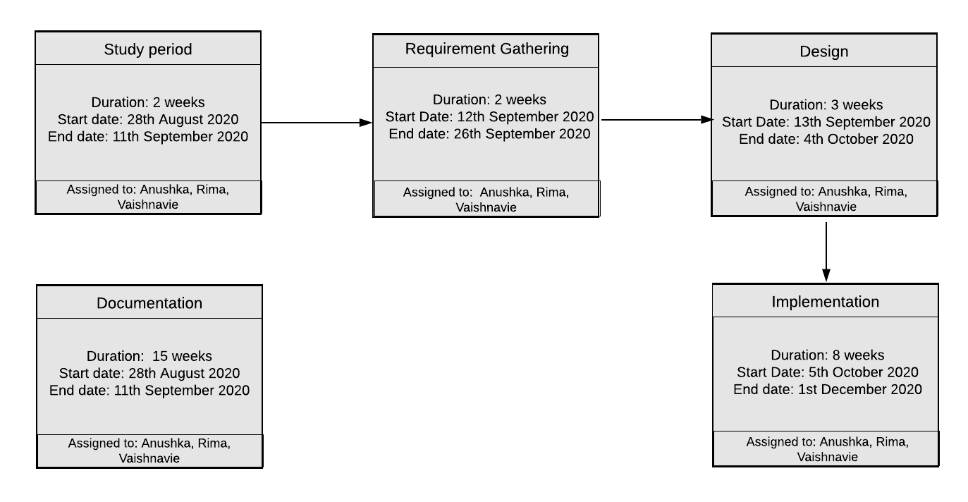
Workflow
Figure 17: Work Flow

Slide 26
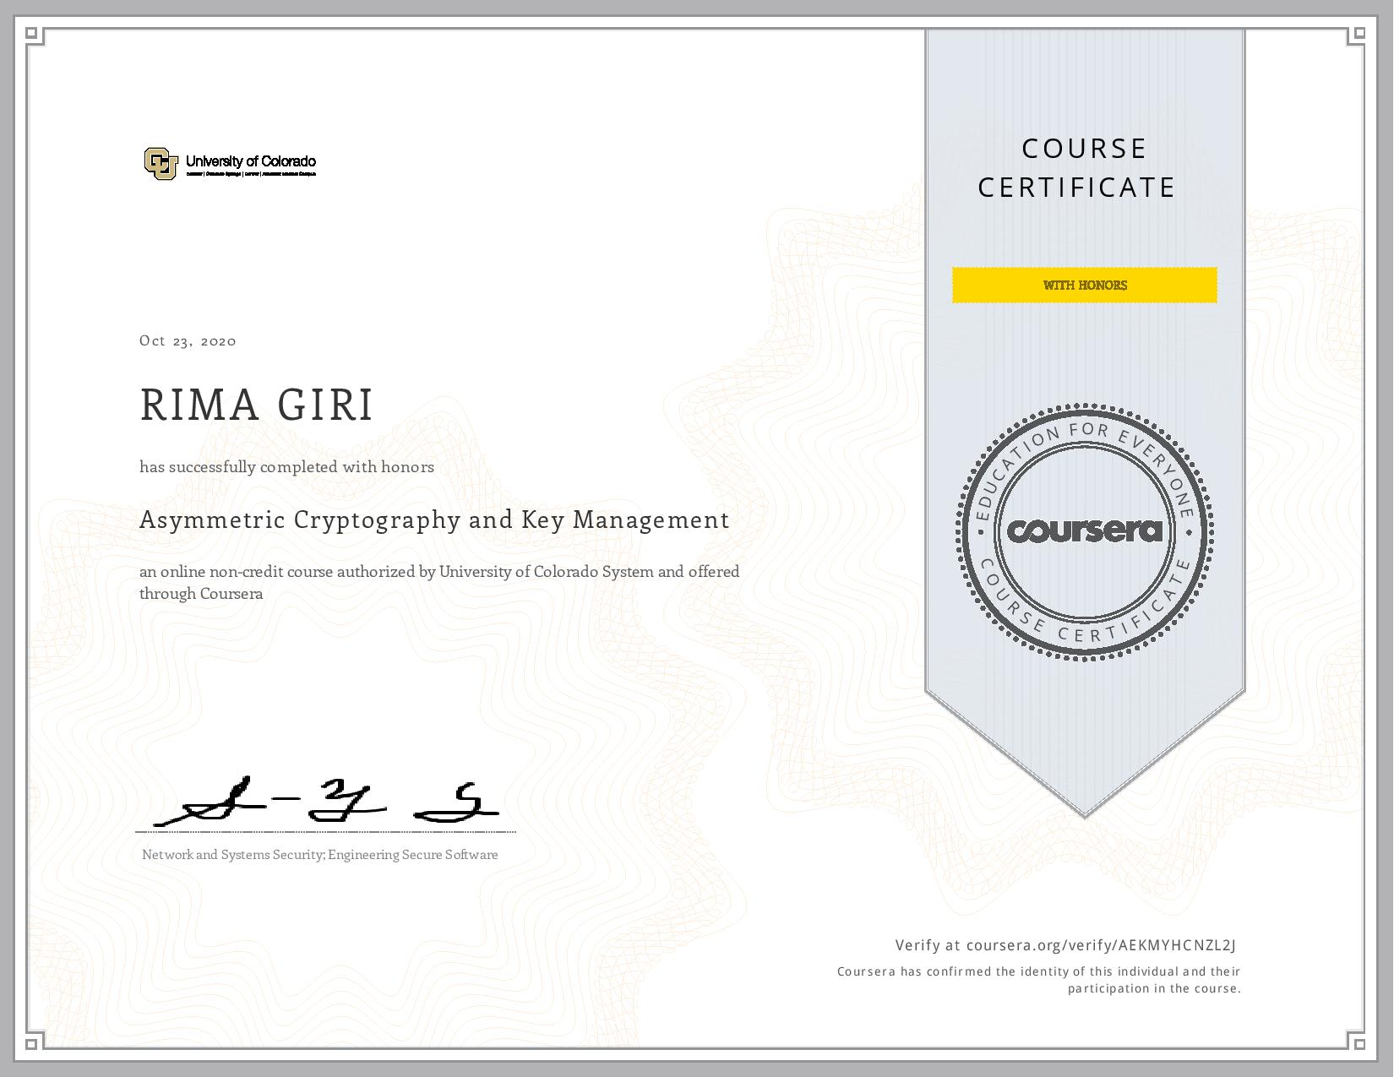
Outcome [5]
Figure 18: Asymmetric cryptography and key management certificate: Rima Giri

Slide 27
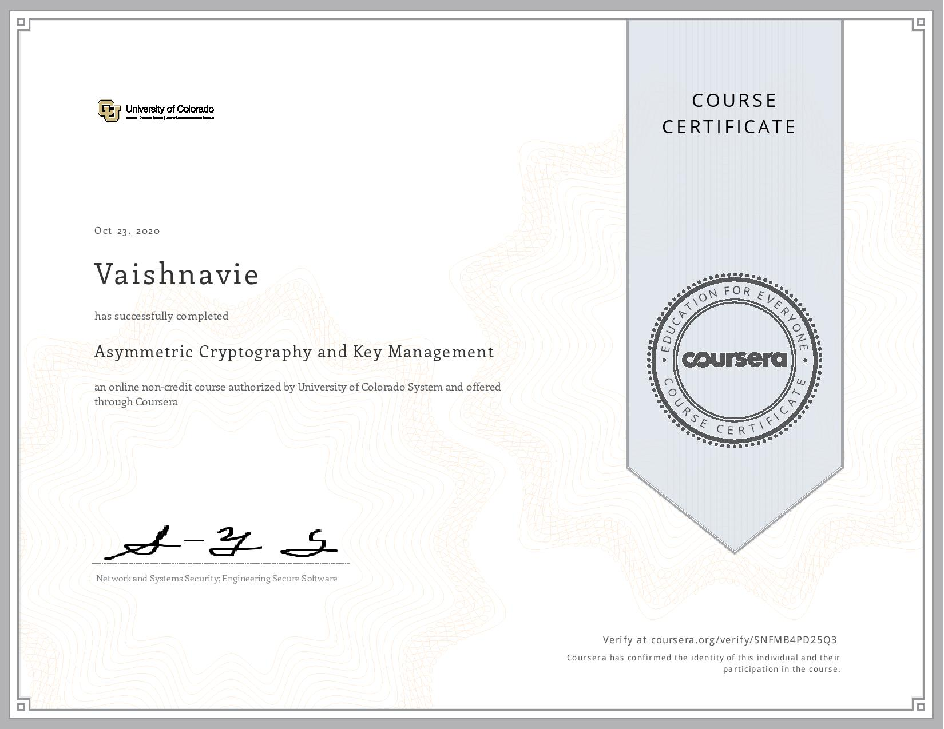
Figure 19: Asymmetric cryptography and key management certificate: Vaishnavie

Slide 28
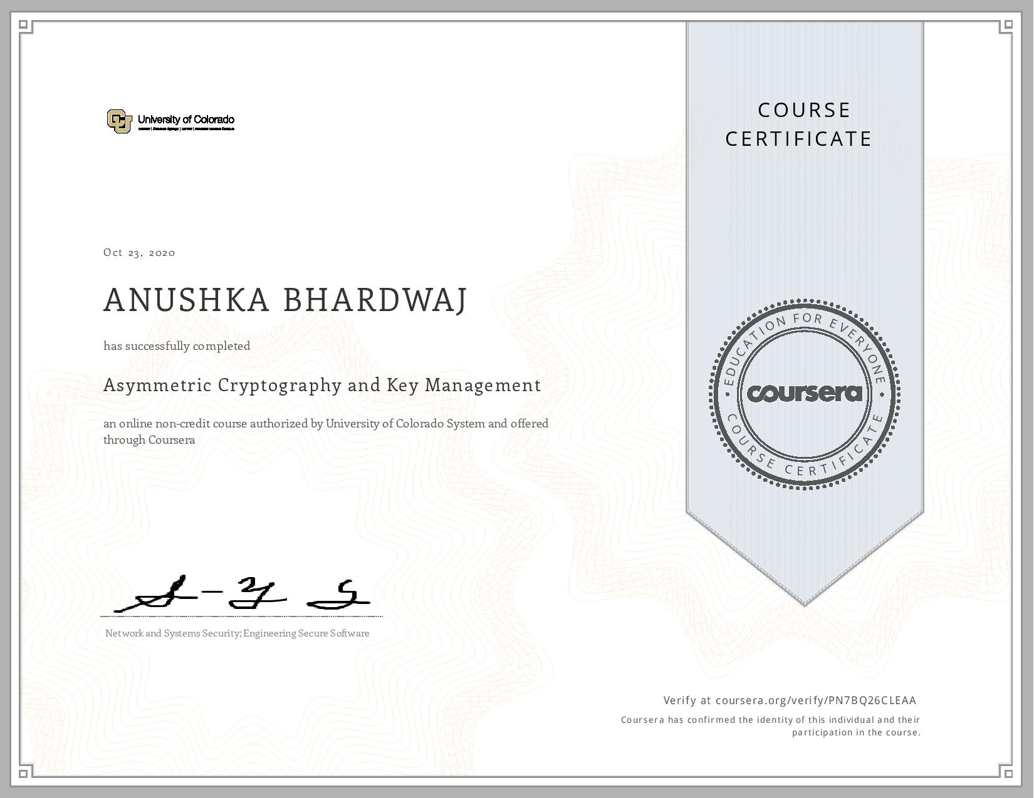
Figure 20: Asymmetric cryptography and key management certificate: Anushka Bhardwaj

Slide 29
References
[1] https://www.edureka.co/blog/what-is-cryptography/
[2] Abdullah Al Hasib, Abul Ahsan Md. Mahmudul Haque, “A Comparative Study of the Performance and Security Issues of AES and RSA Cryptography”, Third International Conference on Convergence and Hybrid Information Technology, 2008.
[3] https://en.wikipedia.org/wiki/RSA_(cryptosystem)
[4] https://stackoverflow.com/questions/37202662/what-is-the-meaning-about-s-i-si-a
[5] https://www.coursera.org/learn/asymmetric-crypto/home/welcome
[6] https://stackoverflow.com/questions/42431189/passing-arguments-parameters-swap-function-and-a-random-number-generator

